Slide 1
Study of Women’s Health in USA
Ralitza Dinesh Mondal

Slide 2
Is health care coverage significant on Women’s Health in USA?
The purpose of this study is to explore some of the different variables that influence the women’s health deterioration in the United States. The study will seek to answer the question, does health coverage play a significant role in the deterioration in women’s health? Also, is there a significant difference between the health care coverage and the other behavioral aspects which are obesity, smoking and alcohol consumption?

Slide 3
Variables
Dependent Variable | Values
OVERHLT10 (overall health) | 1=Excellent 2=Very Good 3=Good 4=Fair 5=Poor

Slide 4
Variables
Independent Variables | Values
SMOKERE10 Whether or not smoking regularly | 1=No 2=Yes
ALCHL2410 Whether or not drink daily | 1=No 2=Yes
EXERCIS10 Whether or not exercise daily | 1=No 2=Yes
OTHHAR10 Whether or not taking medication for heart disease | 1=No 2=Yes
INSURAN10 Whether or not have insurance | 1=No 2=Yes -1=Not Applicable
BMI | Underweight=BMI10<18.5 Healthy=BMI10>=18.5 & BMI10<24.9 Overweight= BMI10>=24.9 & BMI10<29.9 Obese= BMI10>=29.9

Slide 5
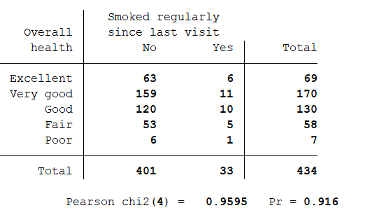
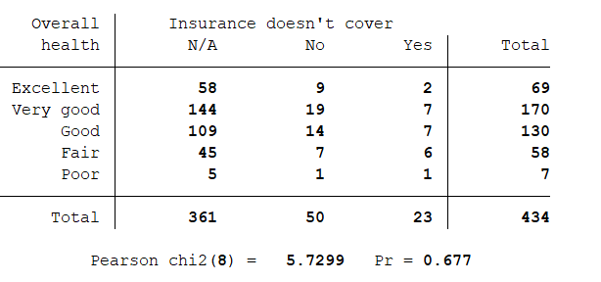
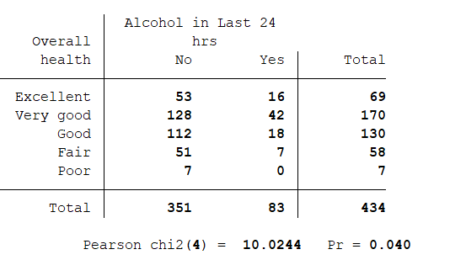
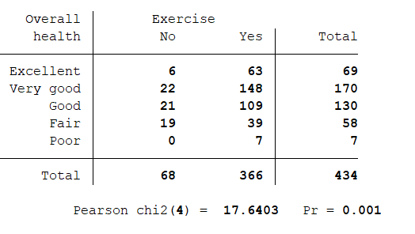
Variables Summary

Slide 6
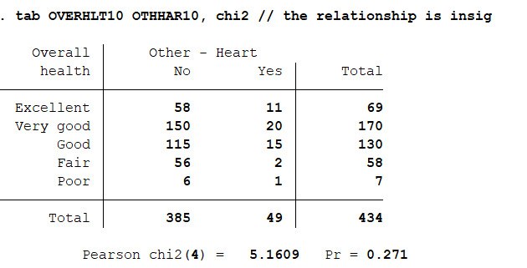
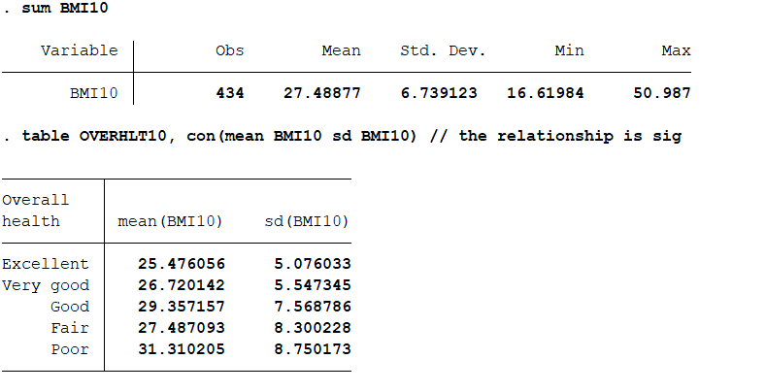
Variables Summary

Slide 7
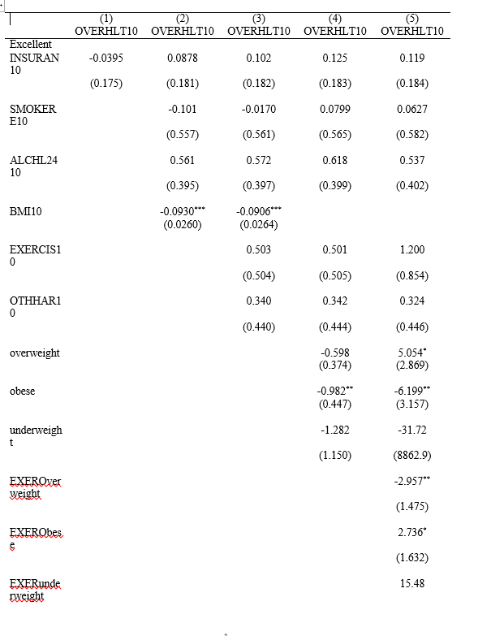

Regression Summary for Excellent health

Slide 8
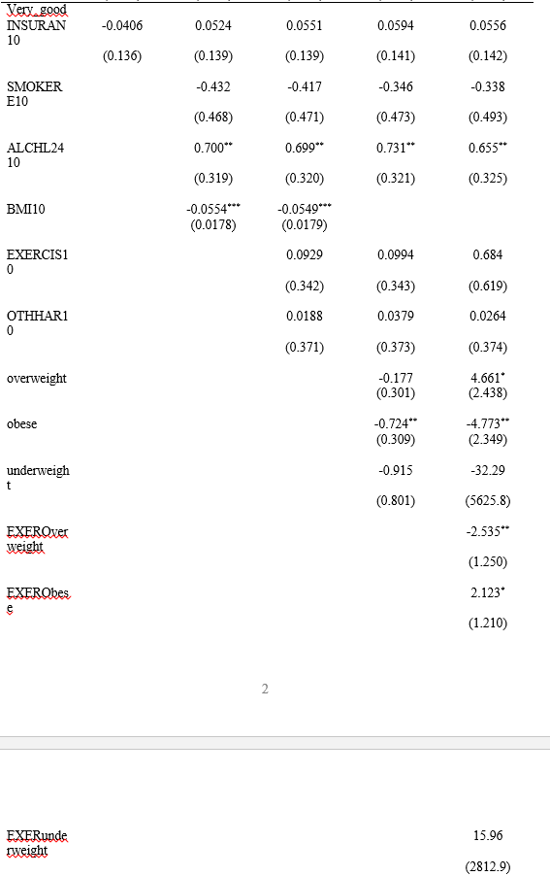

Regression Summary for V.Good Health

Slide 9
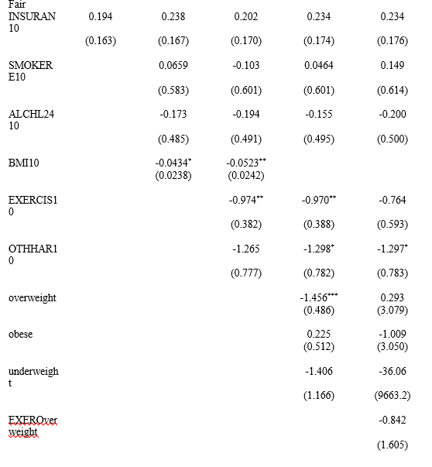
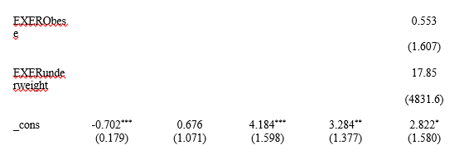
Summary Regression for Fair Health

Slide 10
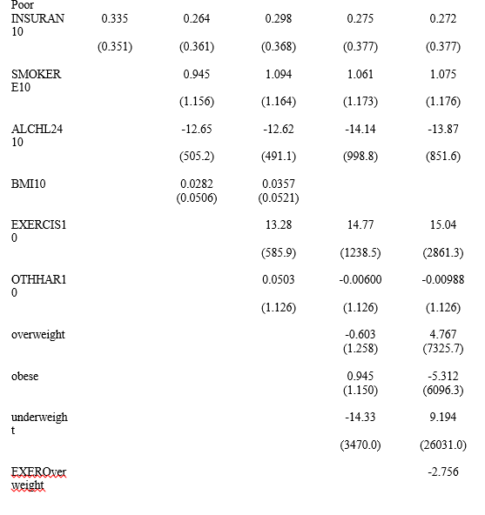
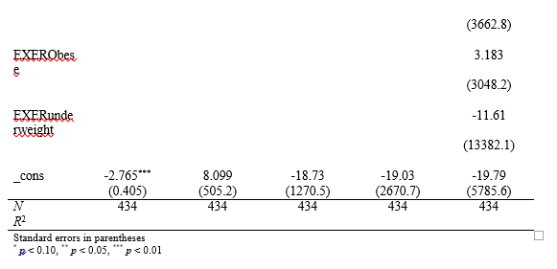
Summary Regression for Poor Health

Slide 11
Conclusion
Health insurance turned out to be insignificant for women’s health for this data set. In stead, Weight was the most significant factor for most stages of overall health.
The interactions for exercise and overweight is sig for excellent health and very good health. Alcohol also played a significant factor in Very good health.
Overweight was the significant factor for fair health. No interactions between exercise and weight was significant.
No factor was significant in determining poor health.
Conclusion, lifestyle factors, like alcohol, exercise and most weight were significant to determine the status of women’s health and availability of health insurance

